Slide 1

Microsoft Azure Women Hackathon

Slide 2

TEAM Hack Overflow
TEAM MEMBERS
Harshini. K
Nagarathe Malavika
Vipanchi Samindla
Rajeshwari Chapparad

Slide 3
PROBLEM STATEMENT
India has one of the lowest shares of women employment. Statistics shows that Indian women contribute only 17% to the GDP, which is far below the average 37%. The reason for this low participation of women, especially rural and underprivileged women, would be the lack of awareness and skill set. They often have limitations to search for jobs within their region of stay and lack of resources that would help them to connect with potential employers. Minimum pay, unsafe working conditions and risks of discrimination are also deterring factors.
Most rural women participate in agricultural activity and informal jobs. With growing household expenses, women have been more actively pursuing employment and involving themselves in their family’s financial matters.
The need for reskilling, stable wage jobs and safe working conditions for women is high.

Slide 4
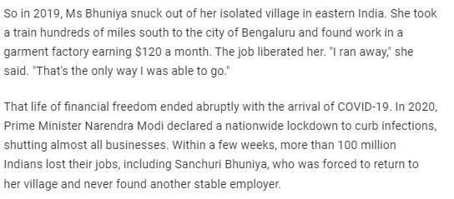
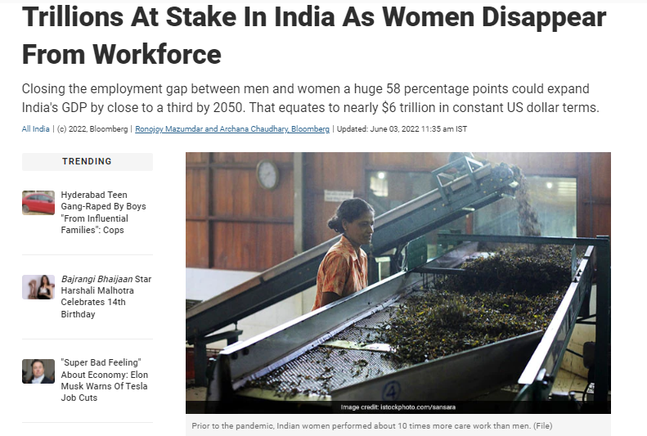
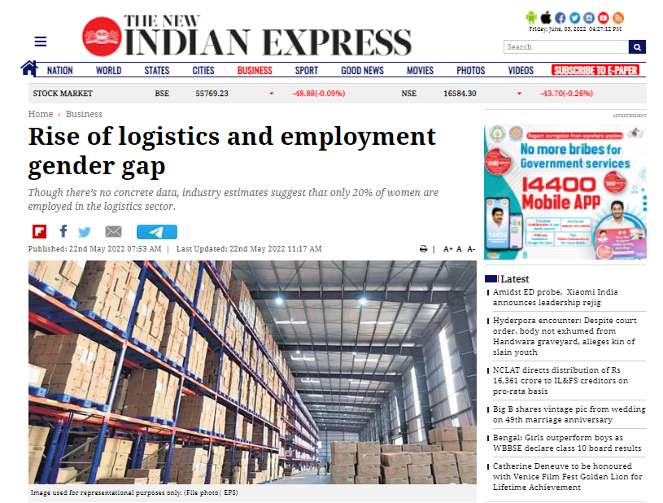
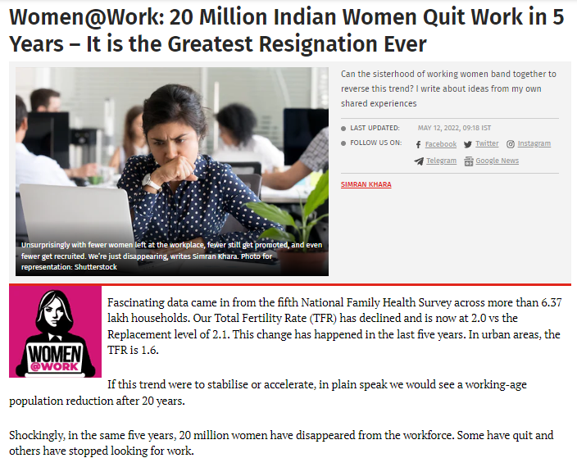
Recent Articles On Women Employment!

Slide 5
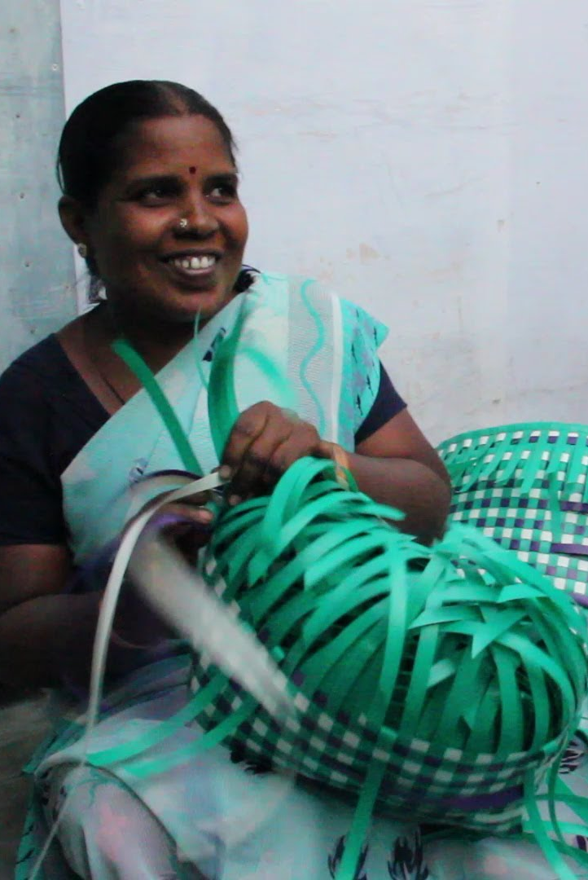
SOLUTION PRESENTED
SHERO - The Job platform for Women
Due to increasing Inflation many women are looking for employment to support their family. At the same time, Many women have lost their jobs due to the pandemic and are struggling to find a stable employment. The gender gap in employment is still high in many fields like Logistics and other non-technical jobs where there are less resources for women to look for employment. SHERO app aims to bridge in the gaps between such women and potential employers.
We are bringing in unique features that will help address and resolve problems faced by rural and underprivileged women.

Slide 6




Technology Stack
Plugins Used: Flutter and Dart
Software IDE : Android studio
Azure services
Machine Learning & Natural Language Processing

Slide 7
AZURE SERVICES
Services | Description | Usage in our Application
Azure Cosmos DB | Build modern apps at any scale using a fast NoSQL database with open APIs. | To store the basic Information in database
Speech Translation | Integrate real-time speech translation into your app | To translate Audio profile message of user.
Blob Storage | Use massively scalable object storage for any type of unstructured data | To store the Gallery of the user profile, etc.
Cognitive Search | Include a cloud search service in your web and mobile application. | To help the User in relevant searching for Events and Jobs.
App Services | Quickly create powerful apps for any platform or device using your choice of tools | Hosting of mobile Flutter app.
Functions | Process events with a serverless code architecture. | Grievance call handling and will raise a ticket after processing the call.
Immersive Reader | Embed text reading and comprehension capabilities into applications. | For users with visual impairment or difficulty understanding the context.
Machine Learning | Develop and run R and Python models on your platform of choice. | Used in creating a Job and Interest based Recommendation system
Reference: https://azure.Microsoft.com/en-in/free/

Slide 8
HIGH-LEVEL FEATURE FLOW
Feature Flow
1. Profile flow
2. Call-in Function
3. Batch Services

Slide 9

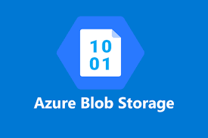


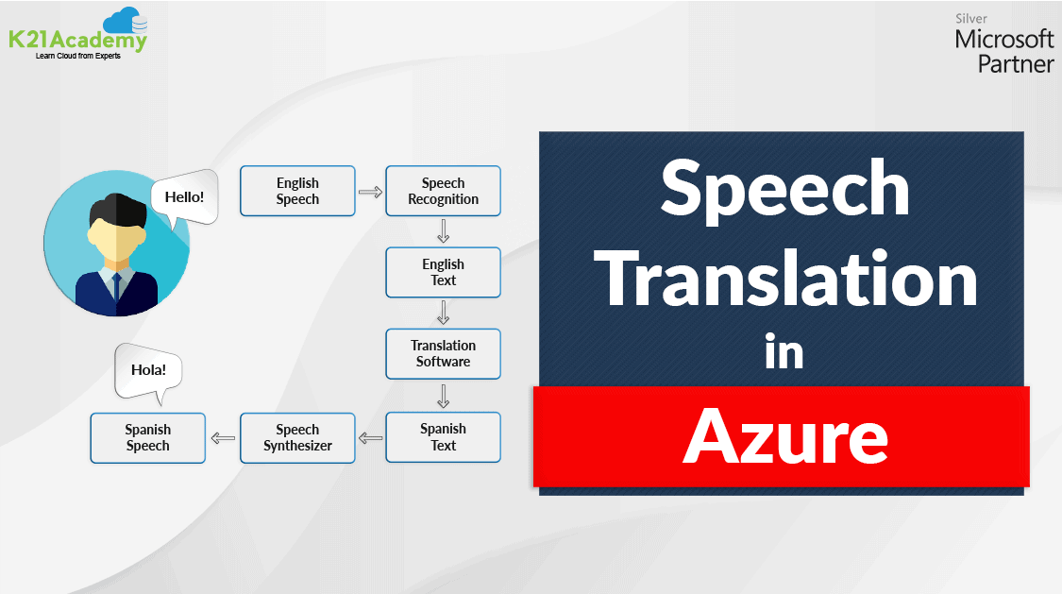
PROFILE FLOW
Profile Information
Profile Picture
Gallery Pictures
Resume PDF
Audio Resume is processed with Azure Speech Translation Service.
This translate the audio resume from regional language and creates English transcript.
Shero Profile Creation

Slide 10
Grievance Call-In Feature Flow
Call-In
Users can call in the grievance phone number for speedy action against scams.
Azure Bot Services, Bot – Telephony Framework
Ticket Processing
Shero app would process the call and raise a ticket for scam addressal
Azure Functions, Azure DB
Action on Grievance
Ticket raised will be sent to the appropriate officer for action
Flutter UI

Slide 11
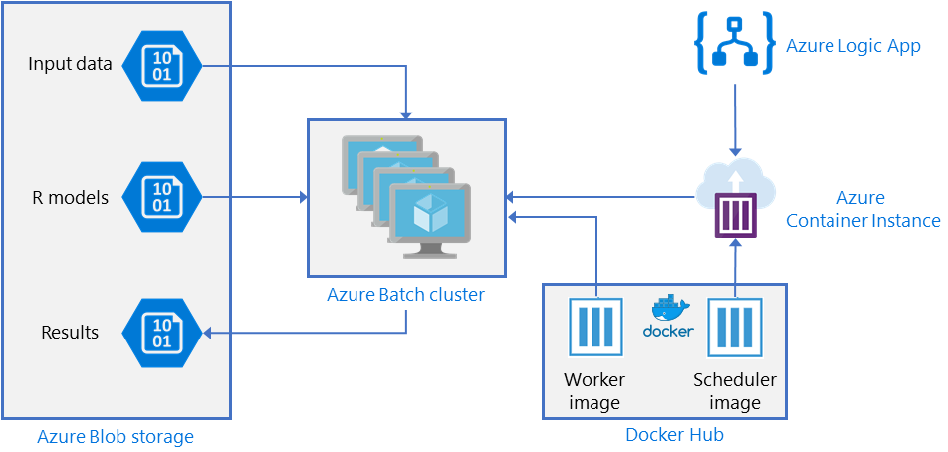
Azure ML Batch Service for recommending jobs
Ref : Batch scoring with R models to forecast sales - Azure Architecture Center

Slide 12
Features
Regional Language Support
Rural Women would be more well versed in their regional language than English. So, Shero app will not only make the app interface user friendly, but additional job or event related posts will also be translated to the user’s language chosen.
Job Recommendation based on Azure Machine Learning
Women have constraints such as location, timings and their own skill level while looking for jobs. The Shero app will use Machine Learning that would enable it to smartly recommend the most suitable jobs.
Events and Groups
There are many workshop for women reskilling conducted by private/government/NGOs. Shero’s Events page shows relevant events to the user based on interests and locations.
Shero also has a group page. Women can join groups to meet likeminded individuals, here they can learn more and know the true value of their work.

Slide 13
Features
Grievance Platform
One of the main concerns, unethical or unsafe workspace and underpayment. They are many instance of scam jobs, that do not pay after work. Shero offers a grievance page that would allow women to anonymously alert relevant officials about the issue.
Additionally, a Call-in Function would be available for Women to have speedy action for their issues.
Smart Profiles
Shero app is an app for all women, It does not matter whether they are illiterate, do not have smartphones, or have a disability.
Shero profiles enable women to add in a written resume. They can give an audio resume in their regional language if they are illiterate. If they cannot explain their experience in words, we have a gallery where they can put in picture of their work. Smart skill tagging will draw in potential employers to their page.

Slide 14
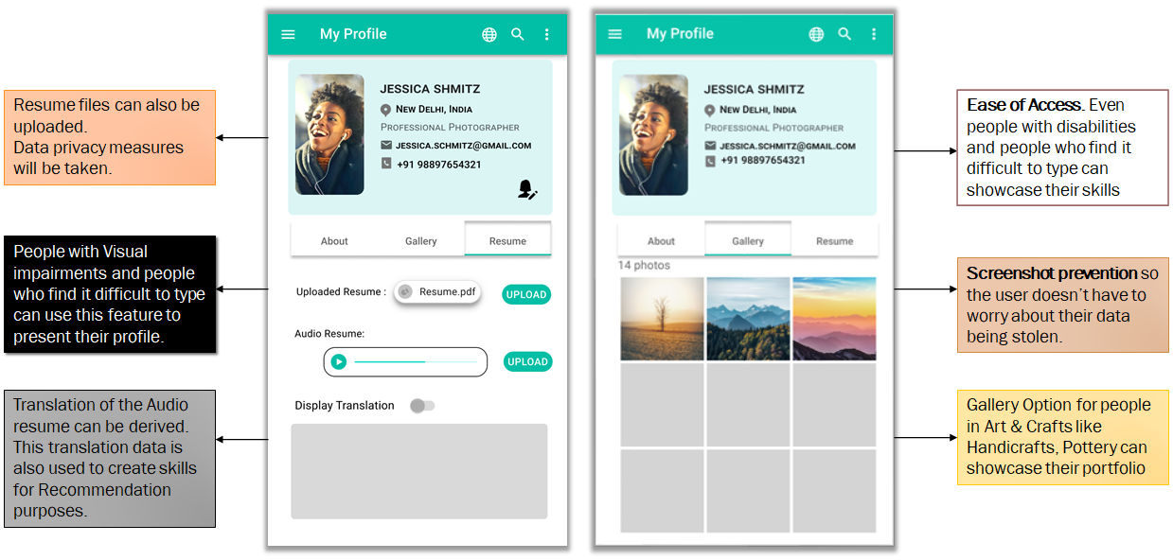

Slide 15
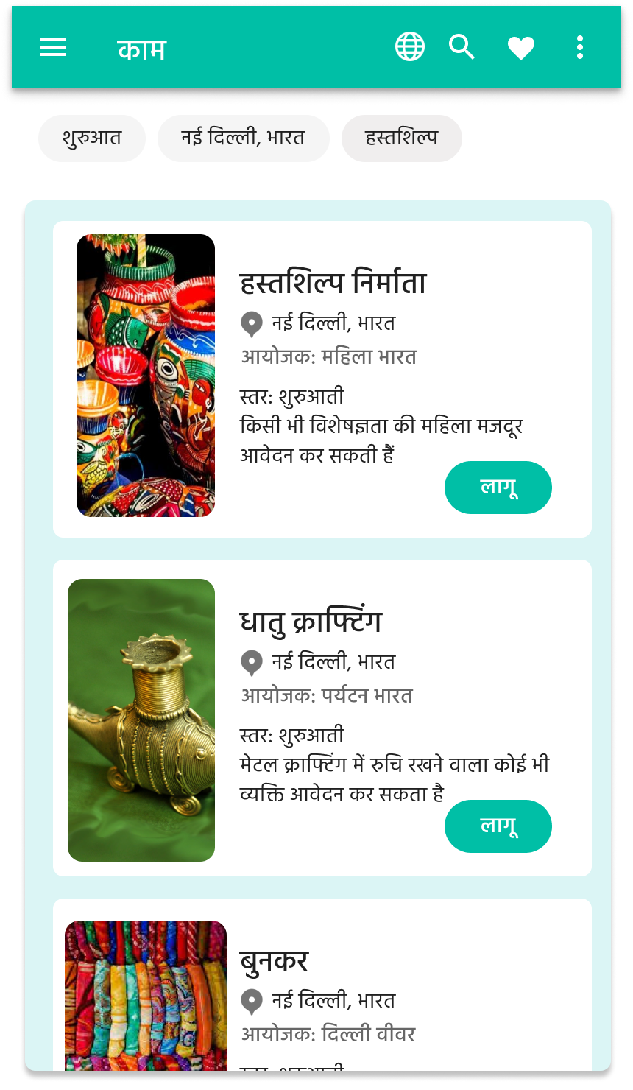
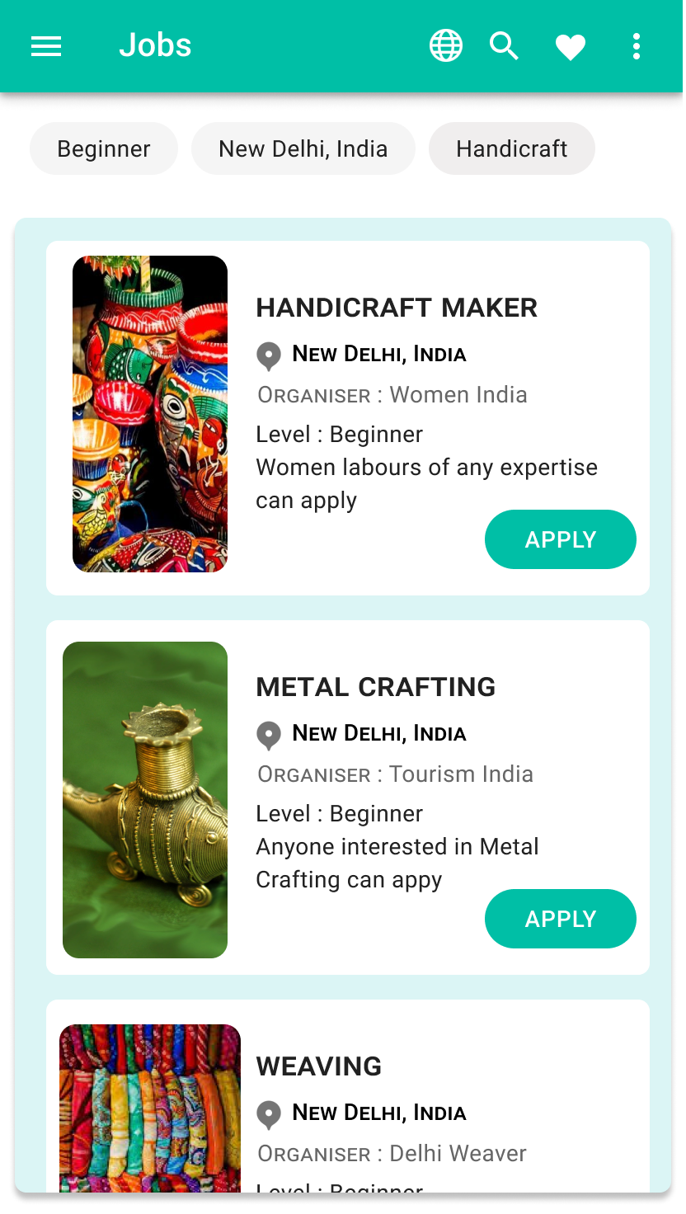
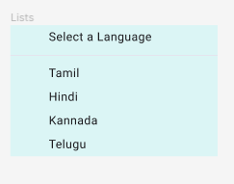
The App Interface and Posts are translated to the User’s preferred Language
User can pick the Regional Language they prefer from the Dropdown

Slide 16
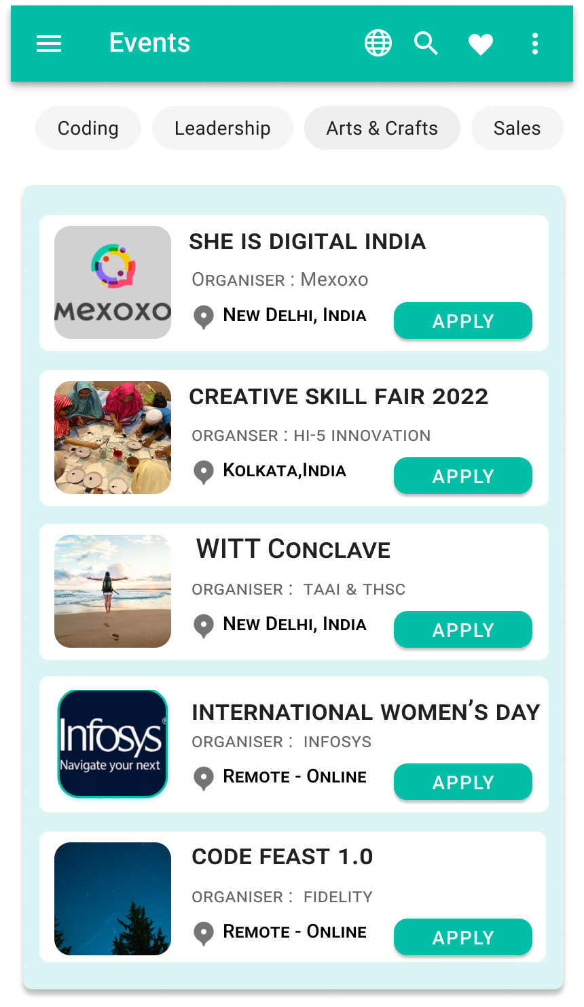
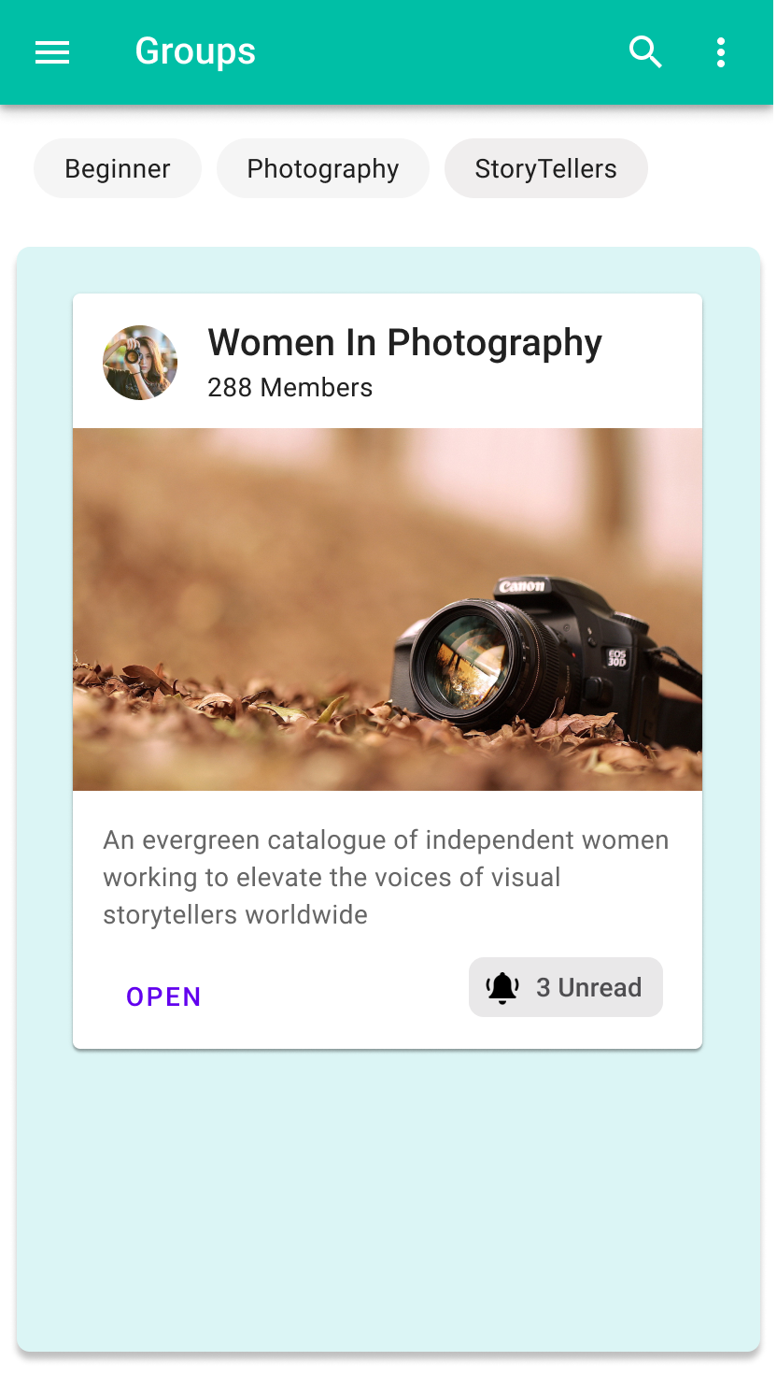
User can select the events based on interested category.
User can join Groups to find people with similar interests and Interact with them.
People who contribute and help the fellow members of the group are provided with rewards and gifts
Events based on Locations and Interests are Recommended

Slide 17
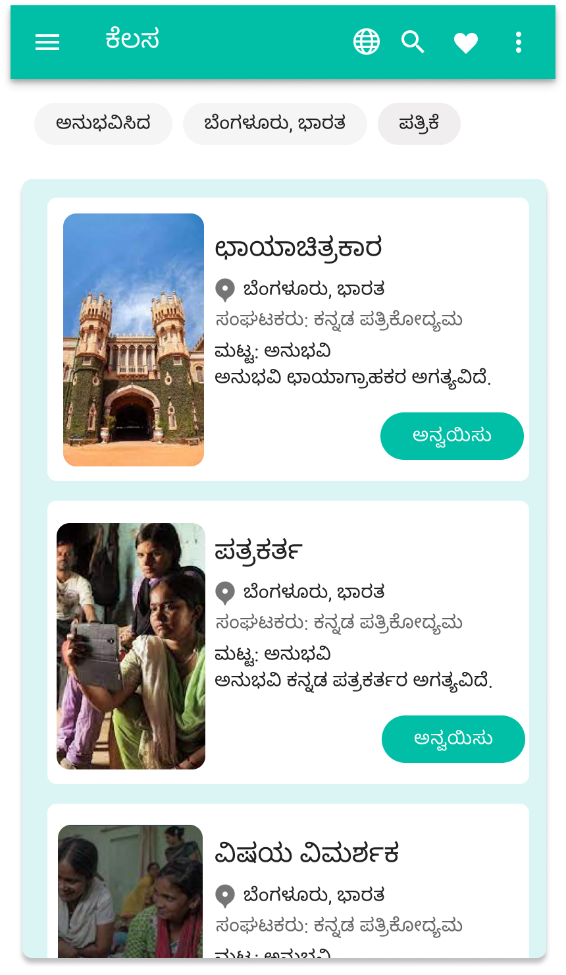
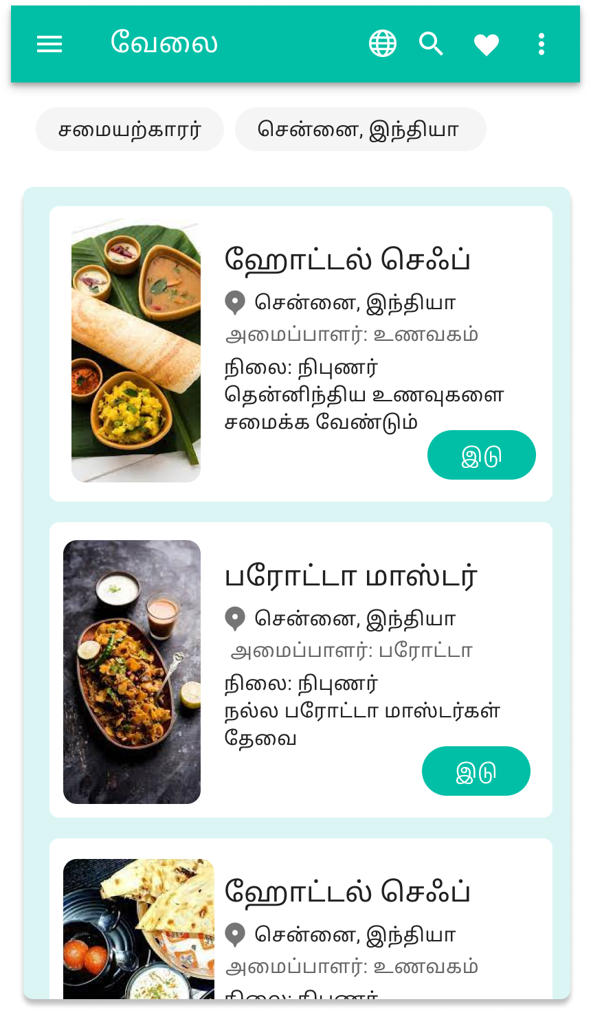
Location based
Recommendation
Skill-set and Interest Based Recommendation

Slide 18
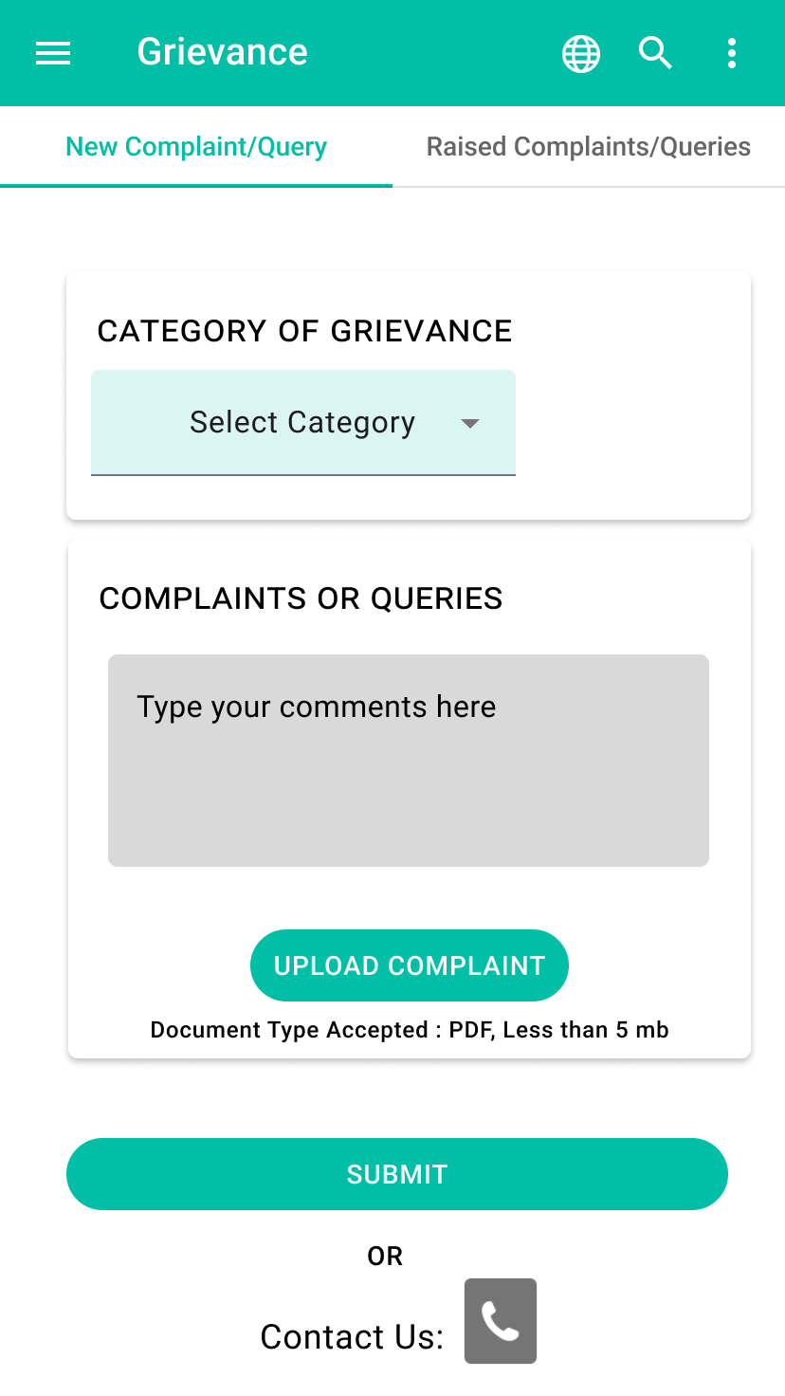
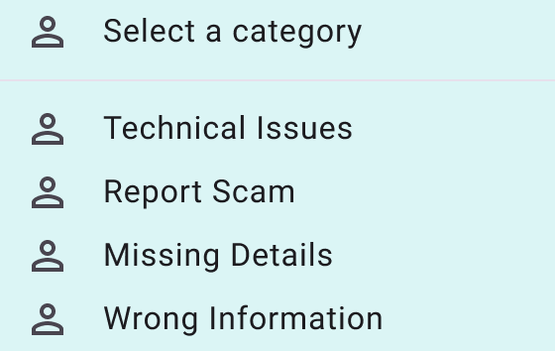
Different Types of issues are addressed by the grievance platform.
Grievance or Queries can be submitted via the app. Shero will raise a ticket and submit it to an officer.
Grievance can also be submitted via a Call-in.
The Phone number for the Call In is linked here.

Slide 19
FUTURE SCOPE
Job Recommendation via Calls
Women can easily make an account and update a profile on Shero if then had smartphones.
But we want to be able to reach interested women with relevant jobs, even if they don’t have smart phones.
Those who don’t have a smart phone should be able to make a profile in the nearest E-center and opt for a “Call ME” service.
This one-time effort will let our Job recommendation System know about her profile and we can automate Weekly calls or messages directly sent to her mobile phone.
Reward System for Group Participants
We want Women to actively participate in their local groups. We want to create a group leaderboard system where they can rank up and earn badges. They earn SHERO point for actively participating in group events, creating helpful content for the community and individually helping out peers.
This helps in keeping the community active and friendly. The short-term benefits includes ranking up rewards and exclusive titles, and Long-term benefits include recognition and better job opportunities.

Slide 20
FUTURE SCOPE
Mentors and Online Web Events
Our app is not just meant for searching jobs but also for reskilling. We want our platform to be the gateway for volunteers who would like to mentor and organize web events.
Groups should be able to organize and record web events. They should be able to create and provide relevant courses on platform that will greatly boost skills and benefit their members.
They can pick out workers to mentor individually by selecting active group members or member from the leader board.
Sponsor and Grants
We provide access directly to women to apply for grants to learn something new.
NGO’s and Corporate Social Responsibility groups can choose to sponsor groups or individuals as they see fit.
Groups benefit from sponsorship by hosting more events and expanding their reach. Companies and NGO get recognition and better talent from groups.
Furthermore, individuals progress can be tracked via their profile. By looking at their achievements and new skill tags.

Slide 21
TWO PIPELINES
USER PIPELINE - People looking for Jobs and Upskilling
Searching Job Requirements
Participating Workshops and Upskilling programs based on Interest.
Location and Interest based Recommendation
Grievance Platform for addressing scams and resolving conflicts.
RECRUITERS PIPELINE - People Posting Jobs and Workshops
Post Job Profiles and Description.
Post Workshops and Upskilling programs

Slide 22
CRITICALITY
ENGAGEMENT
Translation and Recommendation Systems are efficient and provide ease of access but do have limitations in certain cases, which can be tweaked and improved by using the data populated by day-to-day engagement.
Regional Language Support for User Input depends on the Keyboard or Input Support of the user. But providing translation after the content is posted would help resolve this issue. This will also help connect wide range of people.
Providing Rewards and Gifts for people who engage more on the platform and contribute to mentoring or sharing knowledge to fellow users and members of the group. Users can set a target of the reward they want to achieve and start contributing on the platform.

Slide 23
NOVELTY
SCALABILITY
Audio Resume for People who are unable to type. This feature would be helpful for illiterates and people with visual impairments.
Immersive Reader feature would be helpful for people with visual impairments.
Presenting Application in Regional Languages would be useful in choosing the language they are comfortable with.
The Application is developed using Flutter and Dart which enables the service to be available for both android and iOS users.
Providing a Feature to choose from one of the following : Freshers, Working professionals or Women who are taking a break or need assistance coming back to work. Based on the choice, job recommendations and assistance can be delivered.

Slide 24
The Project Timeline
Initial Phase
Post Round 1 Phase
Round 2
Brainstorming
Prototyping
User Pipeline
Regional Language Support
ML Based Job Recommendation
Grievance Platform
Grievance Call-In
Recruiters Pipeline
Product Demo

